Slide 1
Problem Statement Title: Personalized Product Recommendations
Team Name: Minions

Slide 2
Team members details
Team Name | MINIONS
Institute Name/Names | Prasad V. Potluri Siddhartha Institute Of Technology
Team Members > | KOTHURI DHARANI PRIYA

Slide 3
Problem Statement - Brief
The aim is to enhance user experience by implementing a personalized product ranking system.
Our task is to develop an algorithm or model that can generate accurate and relevant product rankings for individual users.
Factors to be considered ;
user preferences
past interactions
product popularity
user similarity

Slide 4
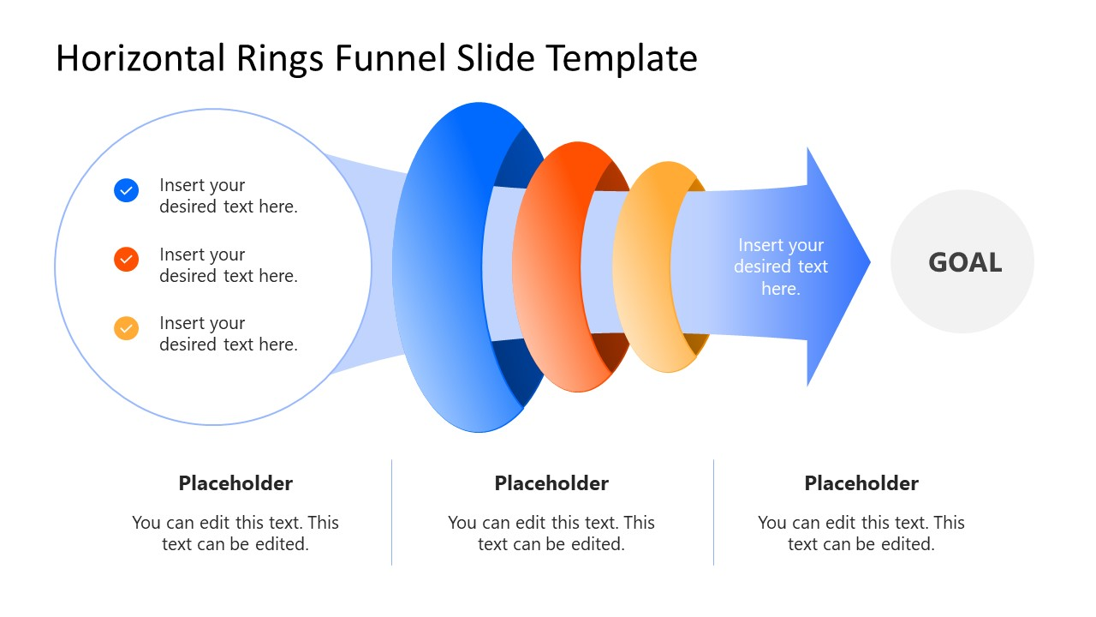
Process
User
preferences
Goal :
Personalized Product Recommendation
System
past interactions
predicting the most suitable products
product popularity &
user similarity
(C)
predicting the most suitable products for a user, based on their unique characteristics and preferences
(A)
Enhancing user experience
(B)
Considering factors in the previous step

Slide 5
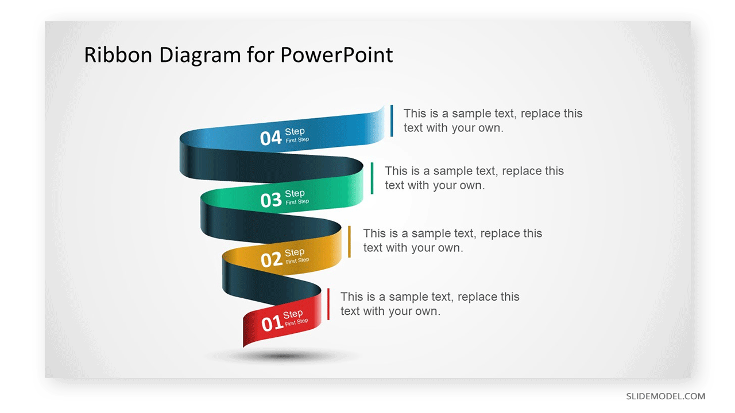
Prediction Analysis
Collect data relevant to your target of analysis.
Organize data into a single dataset.
Clean your data to avoid a misleading model & Create new, useful variables to understand your records.
Choose a methodology/algorithm
& Build the model.

Slide 6
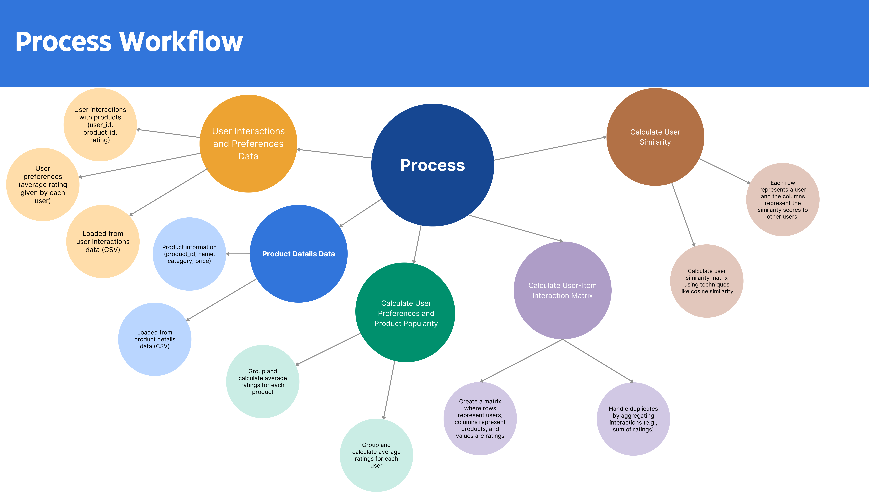

Slide 7
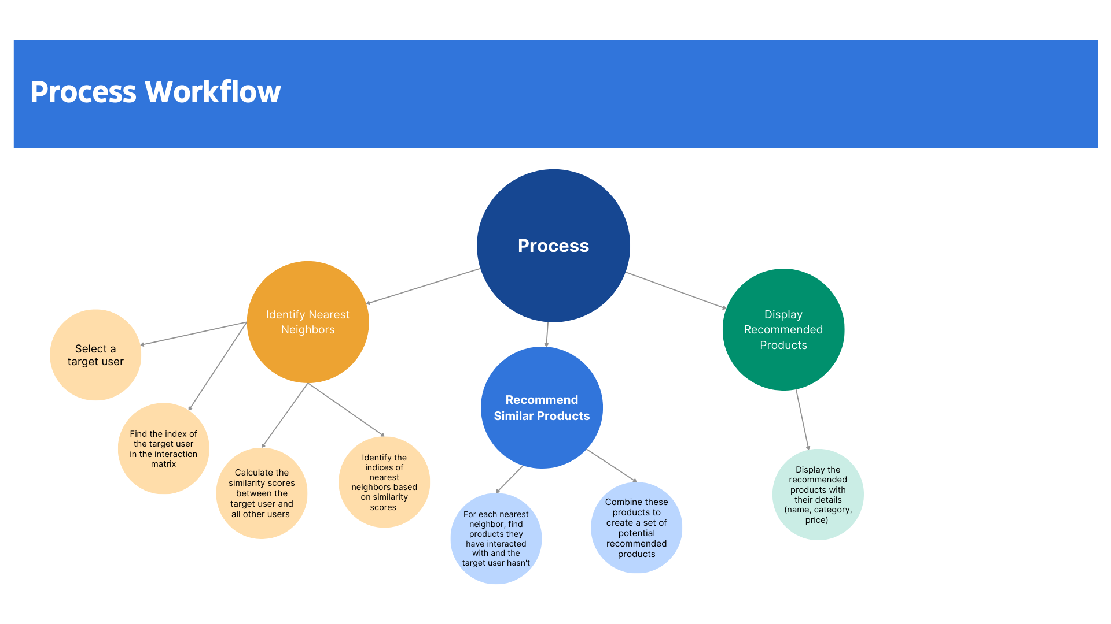

Slide 8
Algorithm | Mean RMSE | Std Dev
Logistic Regression | 3.8488 | 0.4070
Linear Discriminant Analysis | 3.8962 | 0.4493
Decision Tree Classifier | 3.8900 | 0.2625
Random Forest Regressor | 2.3629 | 0.2124
K-neighbors Classifier (KNN) | 4.2275 | 0.4249
GaussianNB | 3.8312 | 0.4931
Support Vector Classifier | 3.8075 | 0.3470

Slide 9
Can access the code directly from the following link provided;
CLICK HERE

Slide 10
Thank You

